Slide 1
Hirehub – ER Diagram

Slide 2
Team 3: Hirehub
List of Entities
Entity | Entity Primary Attributes
Job Seeker | user_id, name, email, password, role
Job Listing | job_id, user_id, company_id, title, description, location, status
Application | application_id, user_id, job_id, status
Employer | emp_name, emp_email, emp_password, company_id
Subscription | subscription_id, plan_type, start_date, end_date, user_id
Support Ticket | ticket_id, issue_type, status, description, user_id
Ad Campaign | campaign_id, user_id, start_date, end_date

Slide 3
user_id
Team 3: Hirehub
Conceptual ER diagram
name
email
Search
Job Seeker
company_id
status
password
Campaign_id
promotes
location
role
User_id
title
Job Listing
Start_date
description
end_date
Ad Campaign
Create
job_id
Create
Create
has
user_id
Application
Employer
ticket_id
user_id
Takes
job_id
user_id
plan_type
emp_name
Emp_password
Support Ticket
start_date
status
Subscription
emp_email
end_date
application_id
emp_email
company_id
Issue_type
status
Subscription_id
description

Slide 4
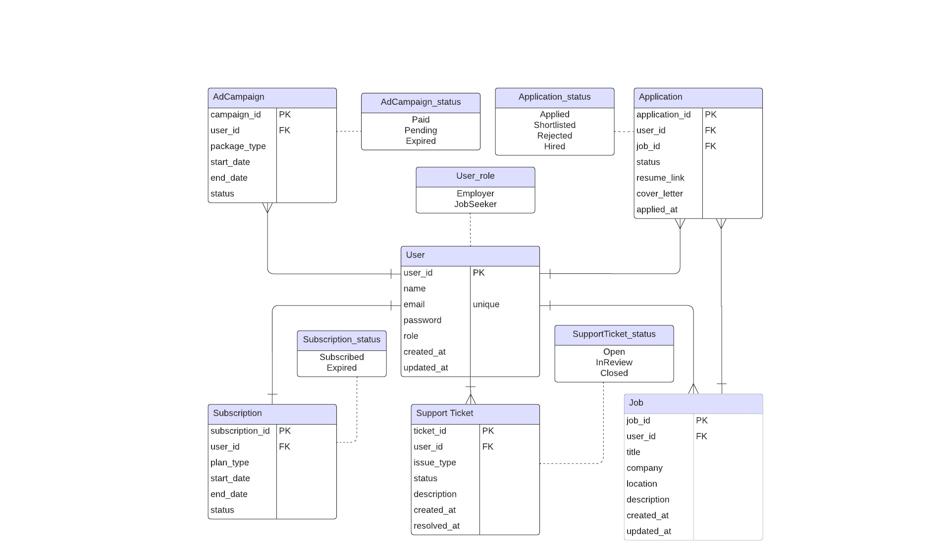
Logical ER diagram

